Slide 1
Installation Guide
(Project Template – codelabor-flex-lcds-template)
2008. 12. 09
CODELABOR
Shin Sang Jae (codelabor@gmail.com)

Slide 2
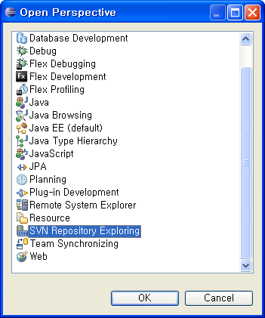
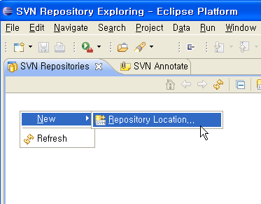
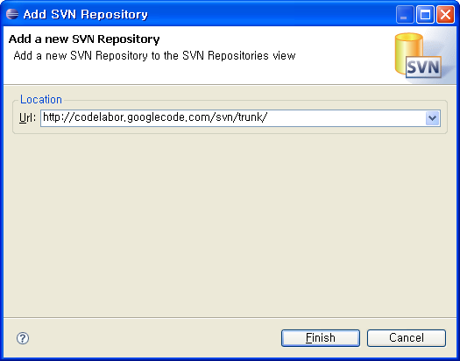
Project Template
Repository
SVN URL: http://codelabor.googlecode.com/svn/trunk/

Slide 3
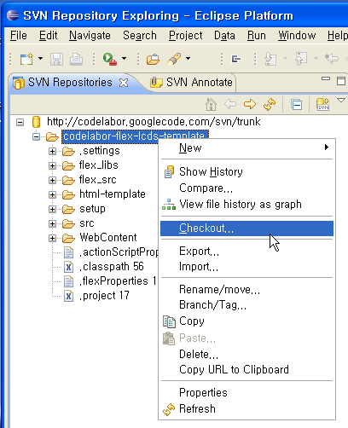
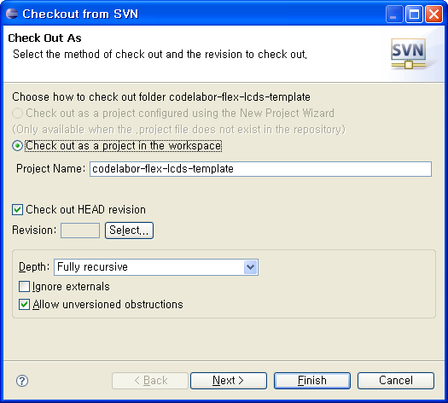
Project Template
Checkout
Checkout Project

Slide 4
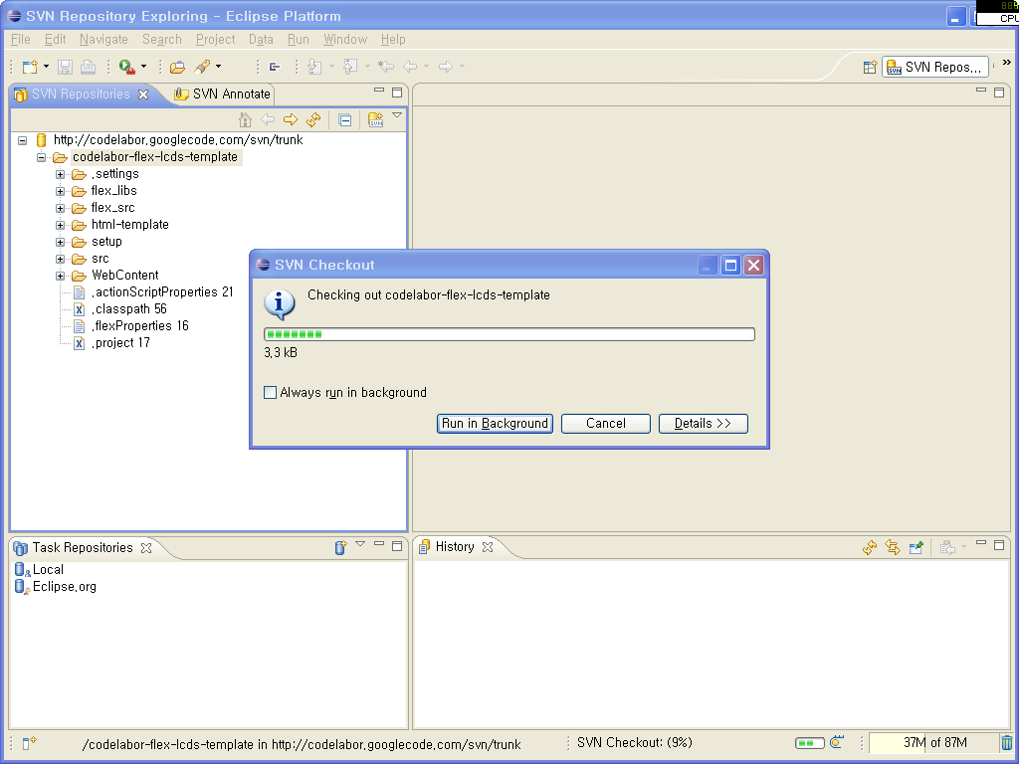
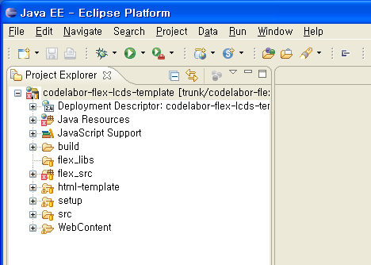
Project Template
Import
Import Project

Slide 5
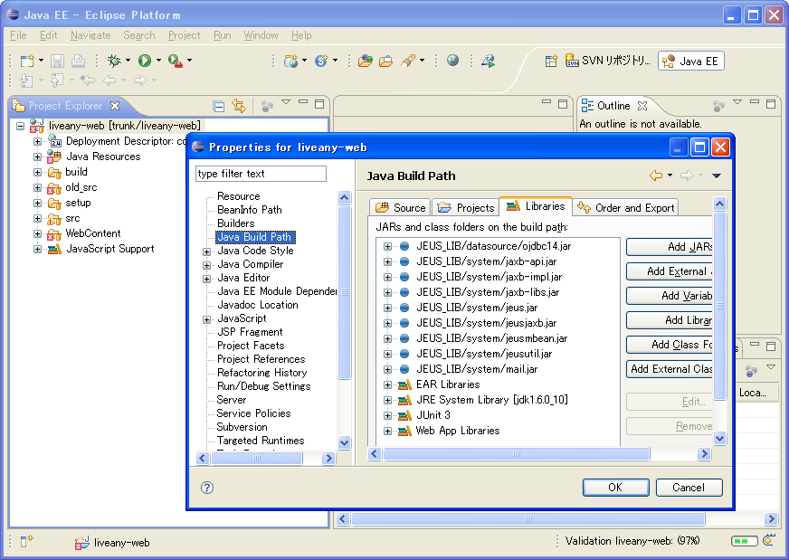
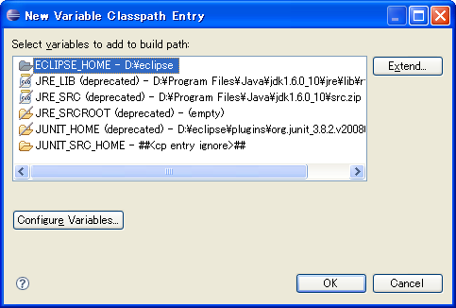
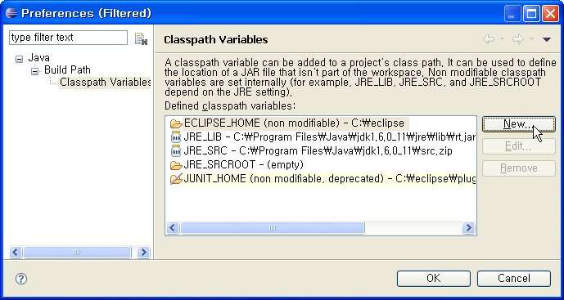
Project Template
Jeus Library
Add Classpath Variable

Slide 6
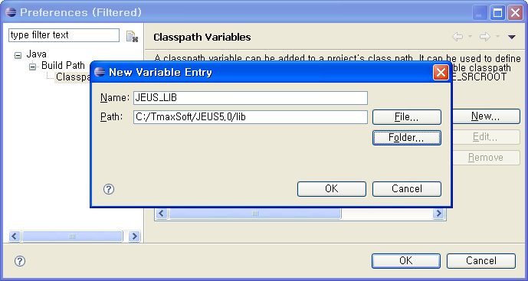
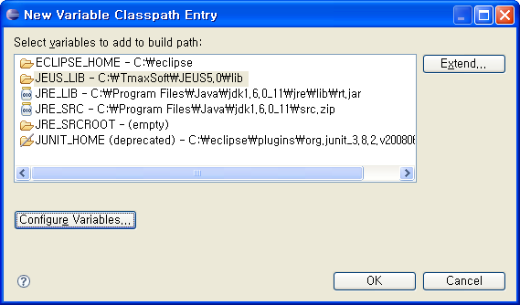
Project Template
Jeus Library
Variable Name: JEUS_LIB
Variable Path: C:/TmaxSoft/JEUS5.0/lib

Slide 7
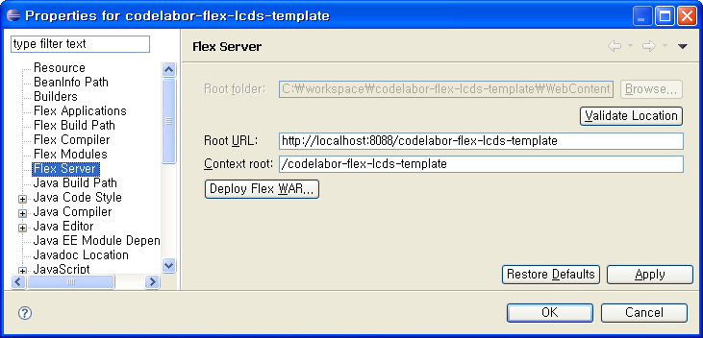
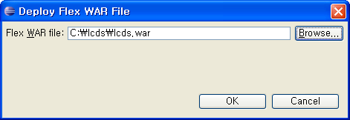
Project Template
LCDS Library
Project Properties > Flex Server
Deploy Flex WAR
Flex WAR file: C:\lcds\lcds.war

Slide 8
Project Template
Flex Configuration
Revert File
  remoting-config.xml
  services-config.xml

Slide 9

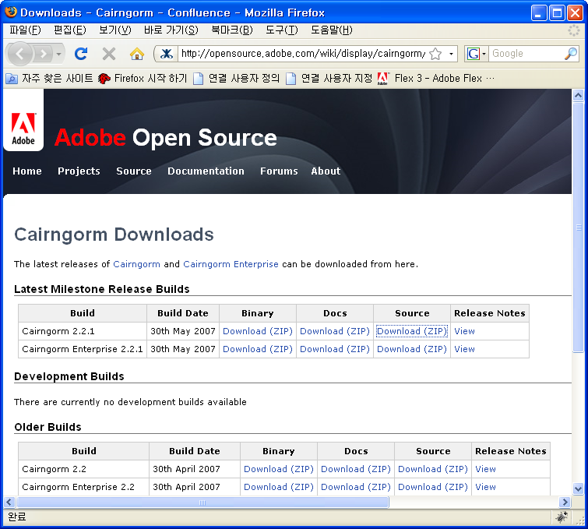



Project Template
Cairngorm Library
Download Site URL: http://opensource.adobe.com/wiki/display/cairngorm/Downloads
Download File:
  cairngorm_enterprise2_2_1-bin.zip (for LDCS)
  cairngorm_2_2_1-bin.zip (for BlazeDS)
Unzip File

Slide 10
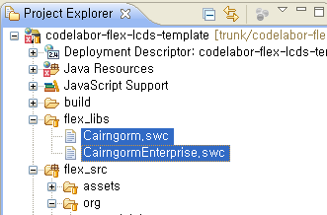
Project Template
Cairngorm Library
Copy SWC Files

Slide 11

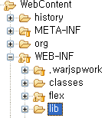

Project Template
Spring Library
Official Site URL: http://www.springframework.org/
Download Site URL: http://www.springsource.org/download
Download File: spring-framework-2.5.6.zip
Unzip File
Copy Files: spring-framework-2.5.6/dist/modules/*.*
Destination Directory: C:\workspace\codelabor-flex-lcds-template\WebContent\WEB-INF\lib

Slide 12
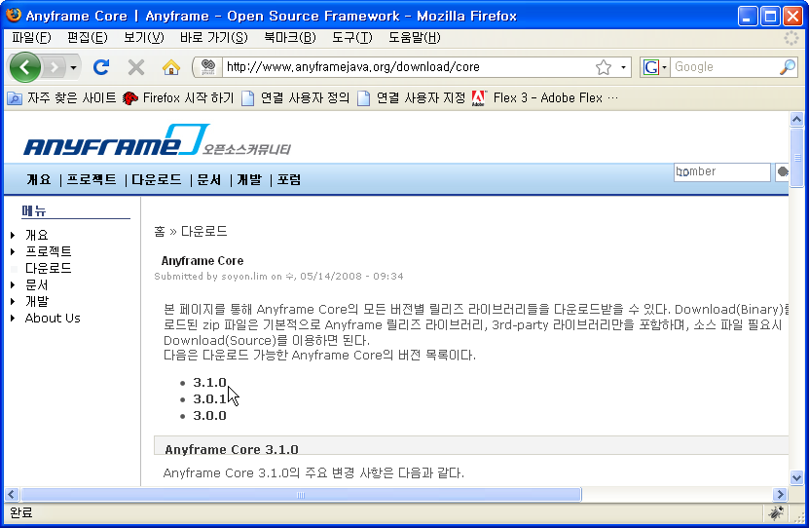

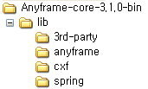
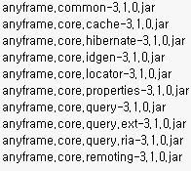
Project Template
Anyframe Library
Official Site URL: http://www.anyframejava.org
Download Site URL: http://www.anyframejava.org/download/core#310
Download File: Anyframe-core-3.1.0-bin.zip
Unzip File
Copy Files: Anyframe-core-3.1.0-bin\lib\anyframe\*.*
Make Directory: C:\workspace\codelabor-flex-lcds-template\WebContent\WEB-INF\lib
Destination Directory: C:\workspace\codelabor-flex-lcds-template\WebContent\WEB-INF\lib

Slide 13
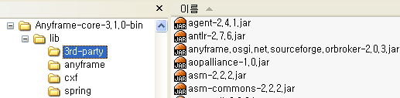
Project Template
Anyframe 3rd-Party Library
Official Site URL: http://www.anyframejava.org
Download Site URL: http://www.anyframejava.org/download/core#310
Download File: Anyframe-core-3.1.0-bin.zip
Unzip File
Copy Files: Anyframe-core-3.1.0-bin\lib\3rd-party\*.*
Destination Directory: C:\workspace\codelabor-flex-lcds-template\WebContent\WEB-INF\lib

Slide 14
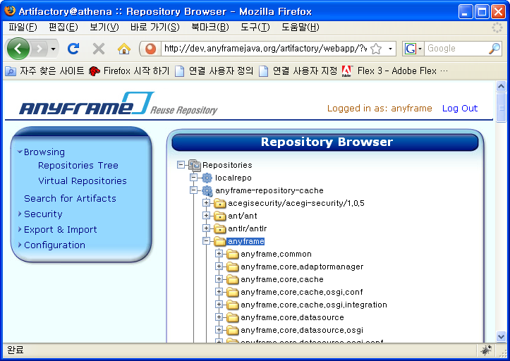
Project Template
Anyframe Patch Library
Official Site URL: http://www.anyframejava.org
Download Site URL: http://dev.anyframejava.org/artifactory
Username: anyframe
Password: anyframe0
Browse repository tree: anyframe-repository-cache/anyframe/

Slide 15
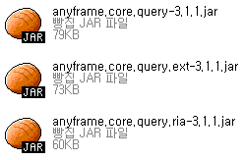
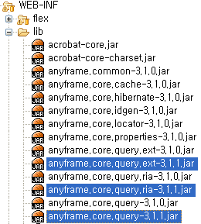
Project Template
Anyframe Patch Library
Download File:
  anyframe.core.query-3.1.1.jar
  anyframe.core.query.ext-3.1.1.jar
  anyframe.core.query.ria-3.1.1.jar
Destination Directory: C:\workspace\codelabor-flex-lcds-template\WebContent\WEB-INF\lib

Slide 16
Project Template
Unused Library
Delete File:
  anyframe.core.query-3.1.0.jar
  anyframe.core.query.ext-3.1.0.jar
  anyframe.core.query.ria-3.1.0.jar
  junit-3.8.1.jar

